Slide 1

Shri Ram College of Engineering and Management
Department of Computer Science Engineering

Slide 2
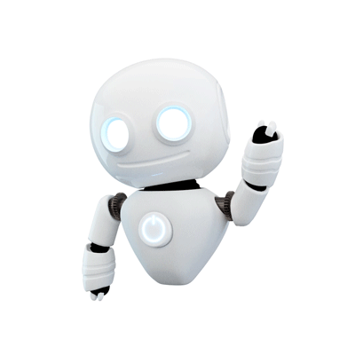
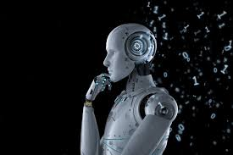
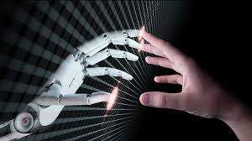
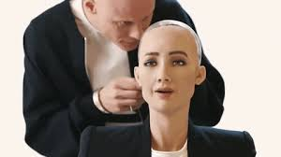
Artificial intelligence
Presentation on
Presented By Kishan
Notes:
Front

Slide 3
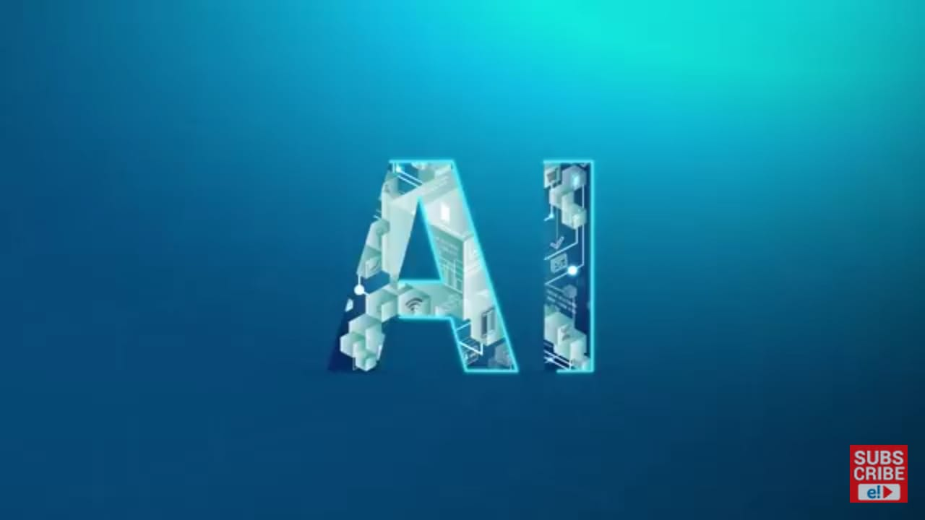
Contents
History
Definition
Why do we need AI ?
Types of Artificial Intelligence
AI, Machine Learning and Deep Learning
Applications of AI
Daily life Applications of AI
Conclusion

Slide 4
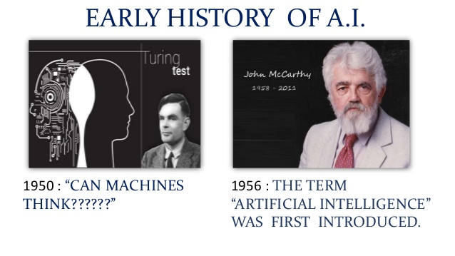
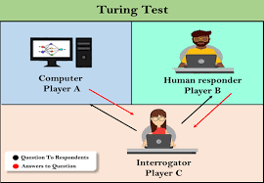
1927-2011
In 1956, American computer scientist John McCarthy organised the Dartmouth conference, at which the term ‘Artificial Intelligence’ was first adopted.
Notes:
History

Slide 5
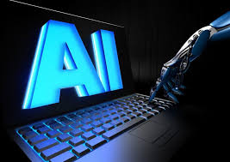
definition
John McCarthy defined Artificial Intelligence as “ the science and engineering of making intelligent machines.”
Notes:
Definition

Slide 6

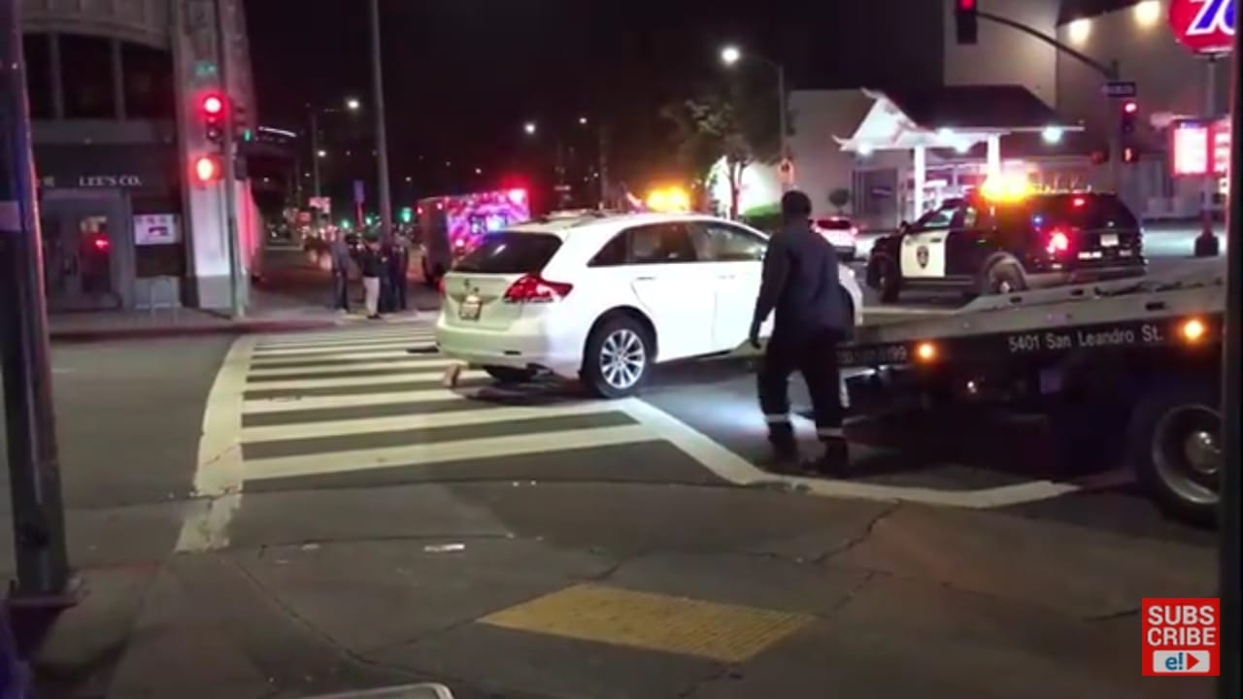
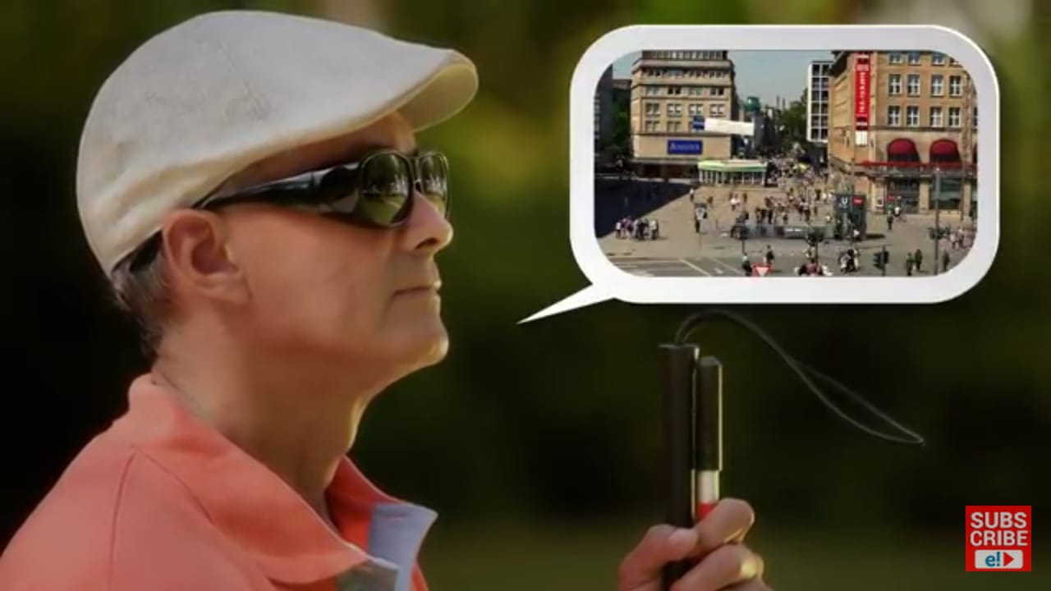
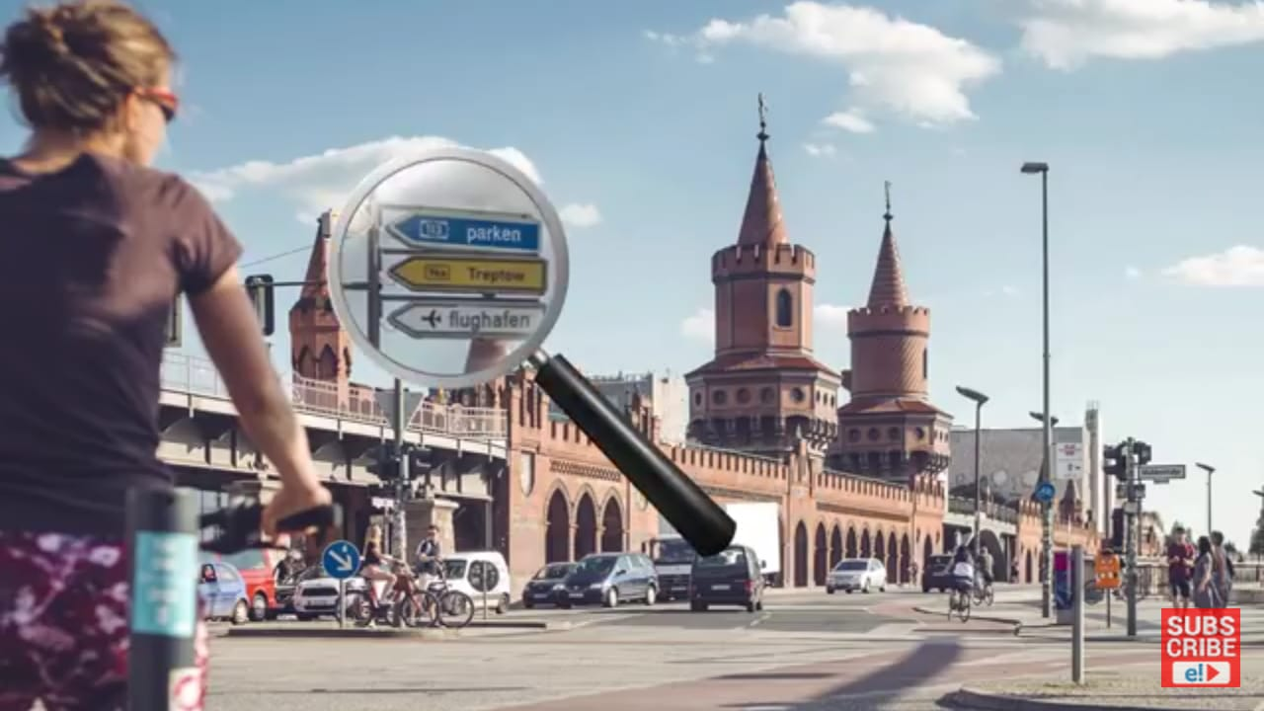
Past
Allen
Accident
Why do we need AI?
Sara
Jack
Notes:
Need

Slide 7
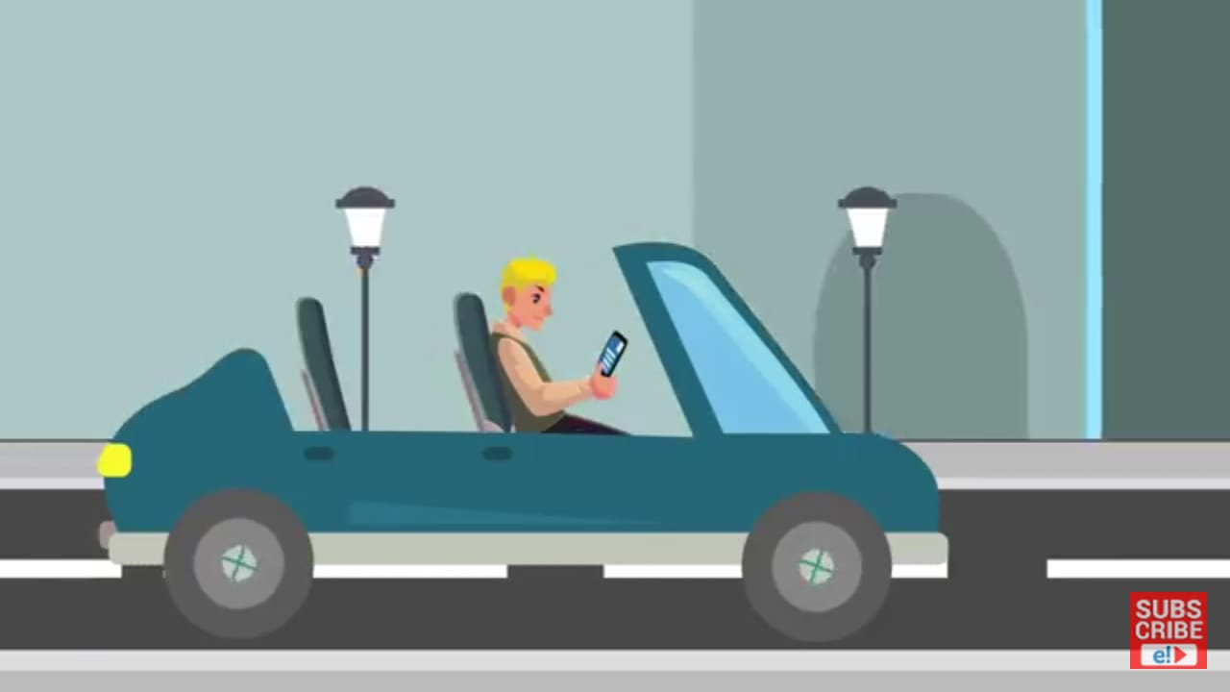
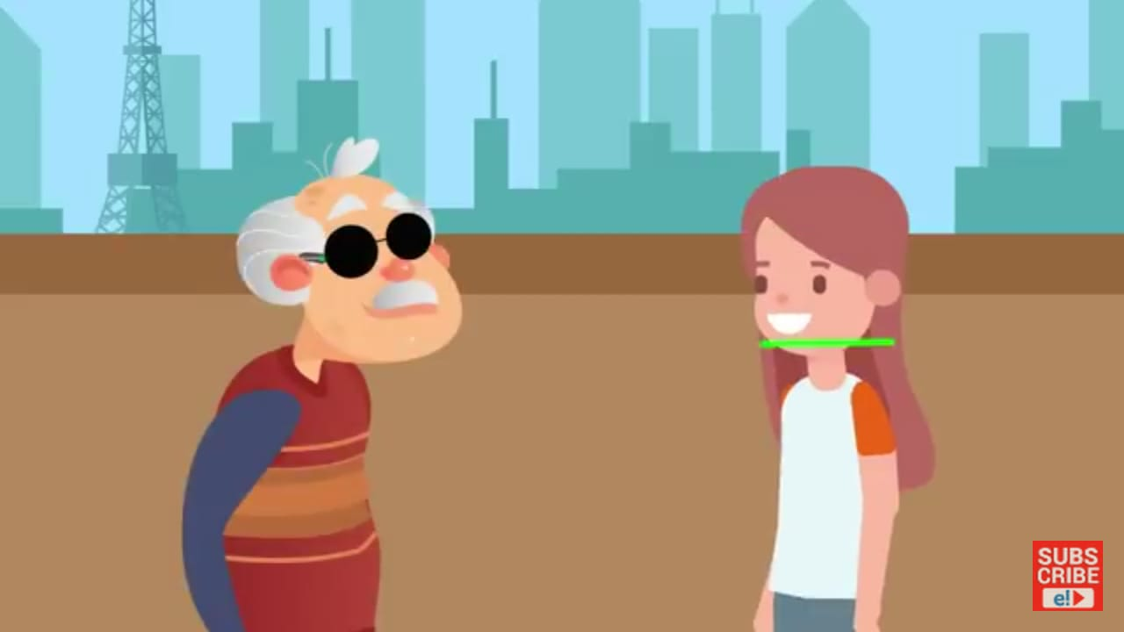
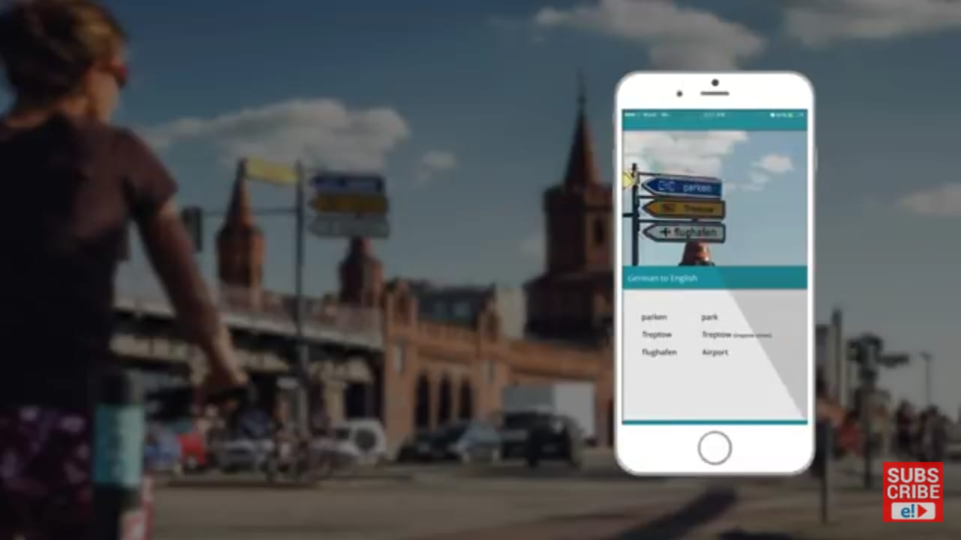

Looking at all the scenarios, What do we understand?
Self driving car
Jack
Sara
Notes:
need2

Slide 8
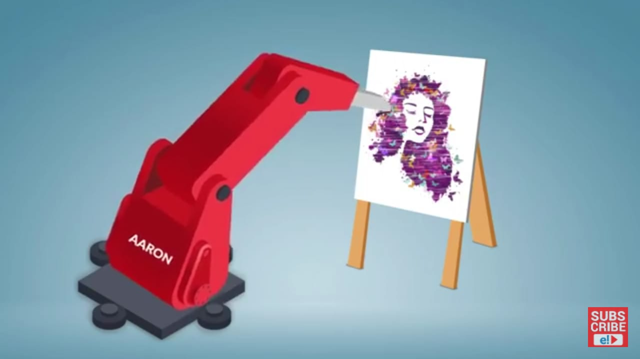
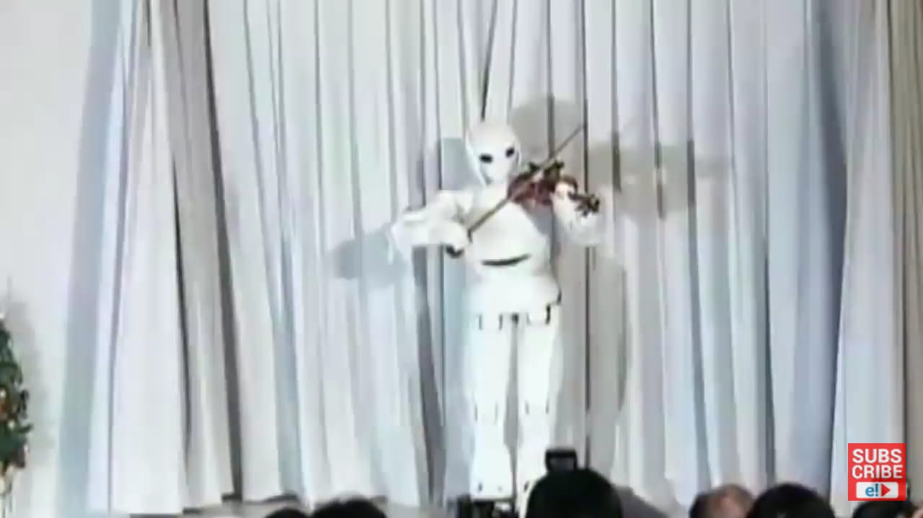
Meet AARON
Composing Music
Notes:
example

Slide 9
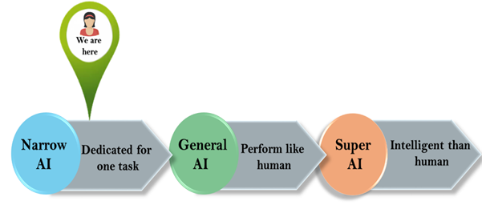
Types of Artificial Intelligence
It involves machines that posses the ability to perform any intellectual task that a human being can.
Super intelligence refers to the time when the capability of computers will surpass humans.
Weak AI
Strong AI

Slide 10
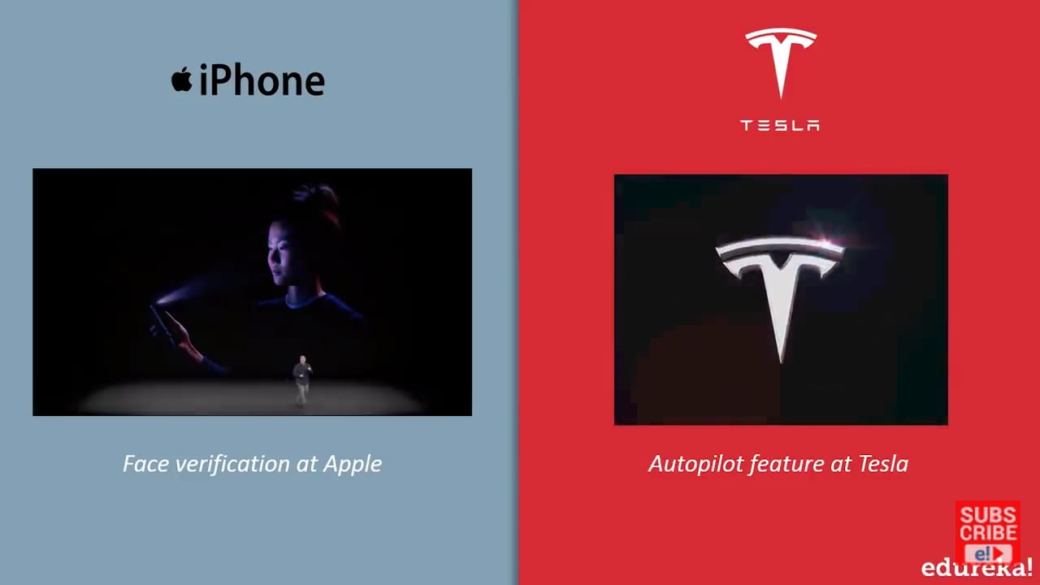
Artificial Narrow Intelligence Examples :
It involves applying artificial intelligence only to specific tasks.

Slide 11
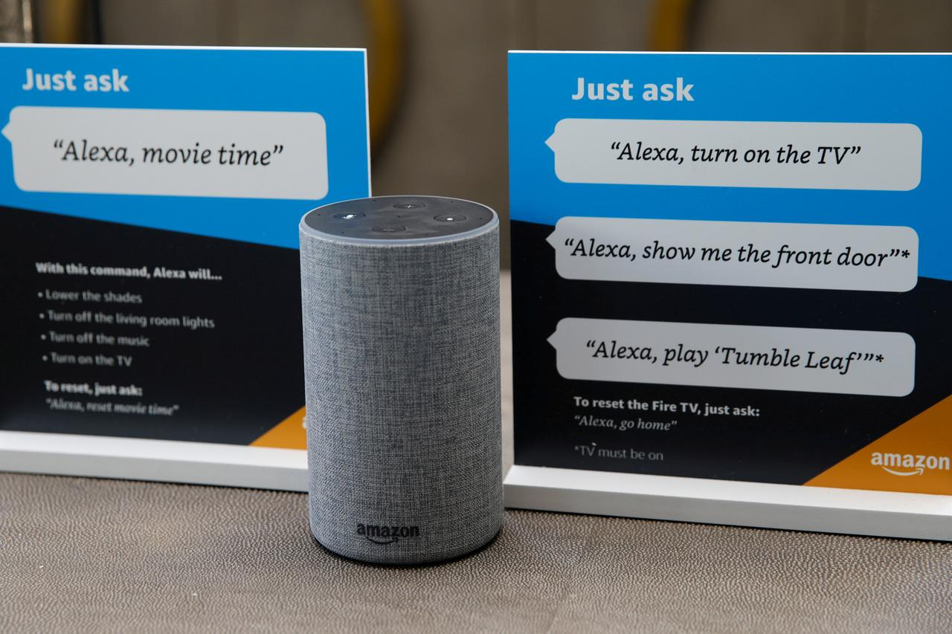

Slide 12
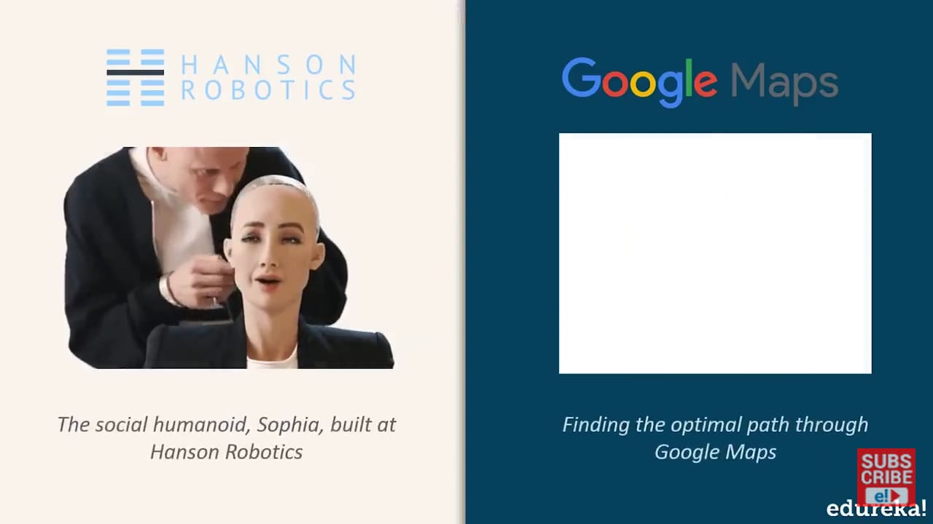



Slide 13
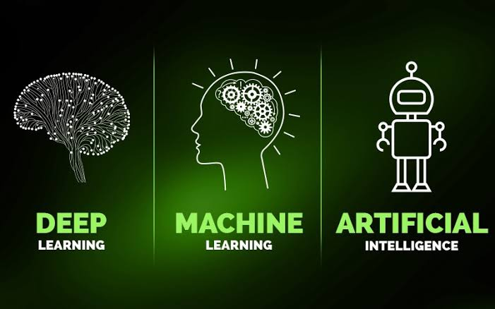

Slide 14
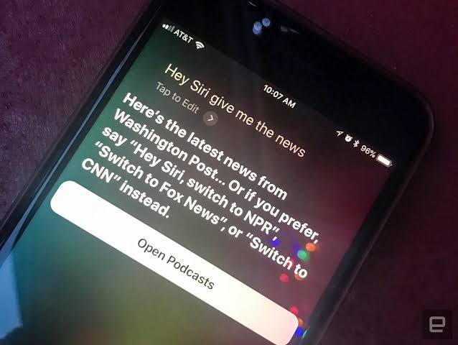
SIRI

Slide 15
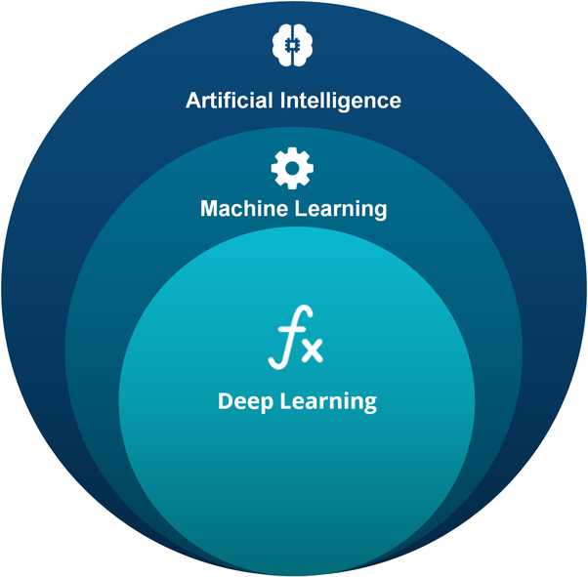
AI is the science of getting machines to mimic the behavior of humans.
A subset of AI that focus on getting machines to make decisions by feeding them data.
A subset of machine learning that uses the concept of neural networks to solve complex problems.

Slide 16
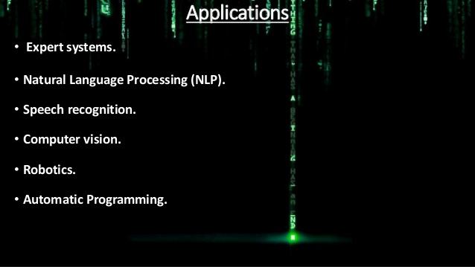
AI covers a vast domain of fields including:

Slide 17
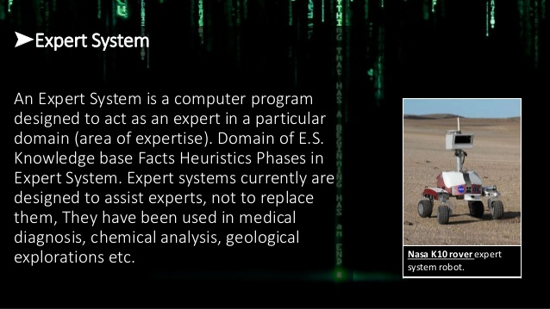
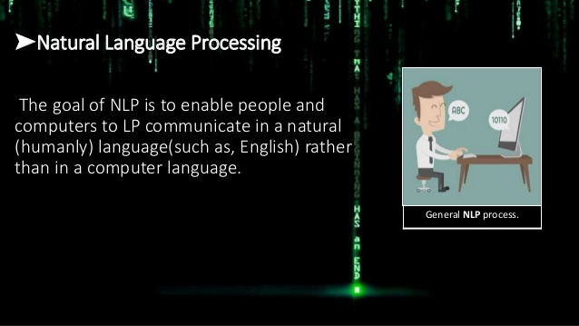
An Expert System is a computer program designed to act as an expert in a particular domain . Expert systems currently are designed to assist experts, not to replace them . They have been used in medical diagnosis, chemical analysis etc.
Natural Language Processing is a branch of AI that deals with the interaction between computers and humans using the natural language such as English. Processing of Natural Language is required when you want an intelligent system like robot to perform as per your instruction. The input and output of an NLP system can be : Speech or written text.

Slide 18
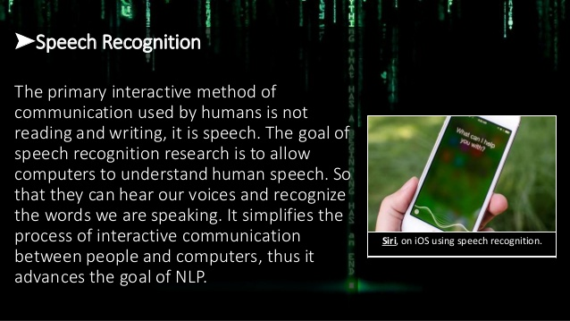
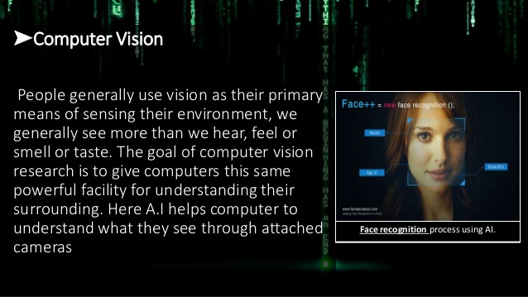
Also known as automatic speech recognition or computer speech recognition which means understanding voice by the computer and performing any required task. The goal of speech recognition is to allow computers to understand human speech . It simplifies the process of interactive communication between people and computers, thus it advances the goal of NLP.
People generally use vision as their primary means of sensing their environment , we generally see more than we hear, feel or smell or taste. The goal of computer vision research is to give computers this same powerful facility for understanding their surrounding . Here AI helps computer to understand what they see through attached cameras.

Slide 19
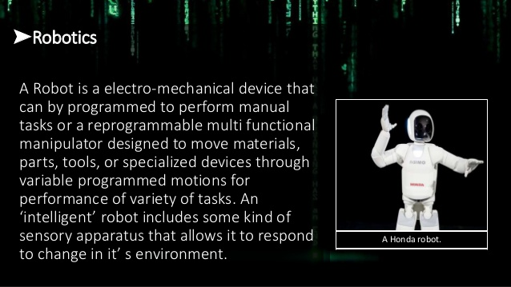
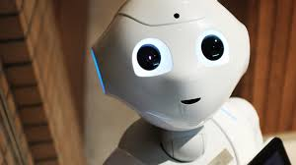
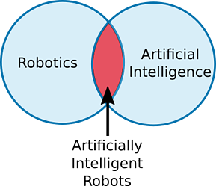
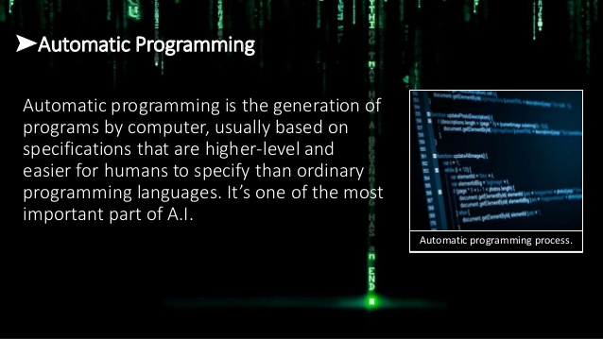
Robotics is a branch of technology that deals with robots. Robots are programmable machines which are usually able to perform a series of actions autonomously or semi-autonomously.
Artificially intelligent robots are the bridge between robotics and AI. These are robots which are controlled by AI programs.
Automatic programming is the generation of programs by computer , usually based on specifications that are higher-level and easier for humans to specify than ordinary programming languages . It is one of the most important part of AI.

Slide 20


Applications of Artificial Intelligence
in daily life
Healthcare
Millions of Healthcare organizations use IBM AI (Watson ) technology for medical diagnosis.
Coming to social media platform like Fb , AI is used for face verification.
Social Media

Slide 21


Another example is Twitter’s AI which is being used to identify hate speech and terroristic languages in tweets.
It makes use of ML, DL and Natural Language Processing to filter up offensive content.
The Google predictive search is one of the famous AI application.

Slide 22
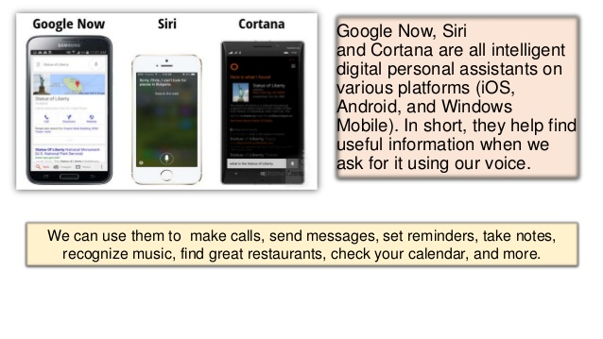
Now, We have virtual assistants like Alexa , Cortana , SIRI, and Google assistant etc.

Slide 23
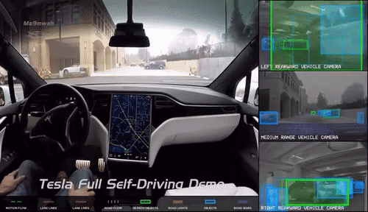
Now, other famous application of AI is self driving cars.
Elon Musk talks a ton about How AI is implemented in Tesla’s self driving cars and autopilot features.

Slide 24
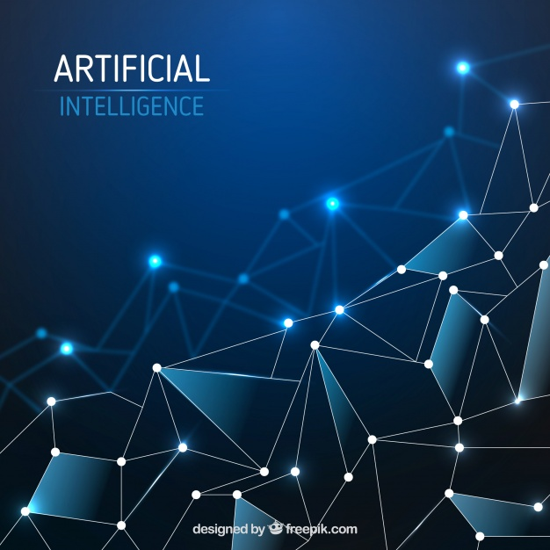
Conclusion
So, I can go on and on about the various applications of AI since the emergence of AI in 1950s, we have seen an exponential growth in its potential.
As AI is branching out in every aspect of our lives , is it possible that one day AI might take over our lives and if it is possible , how long will this take?

Slide 25
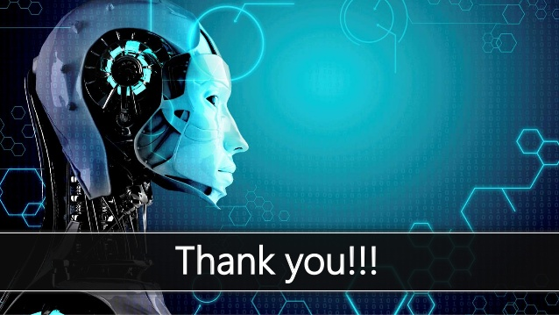

Slide 26

Any Queries ?

Slide 27


